Slide 1

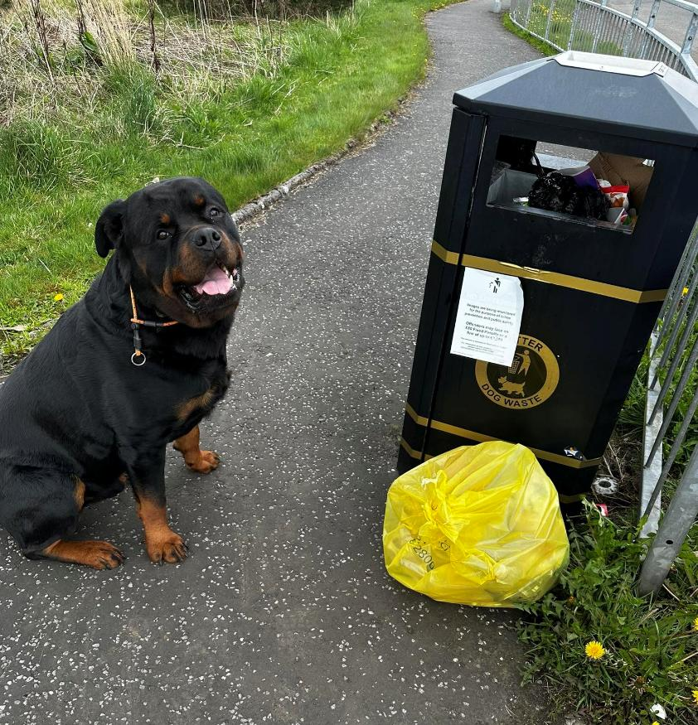
Annual General Meeting 2026
Thor (Nicole Campbell)

Slide 2
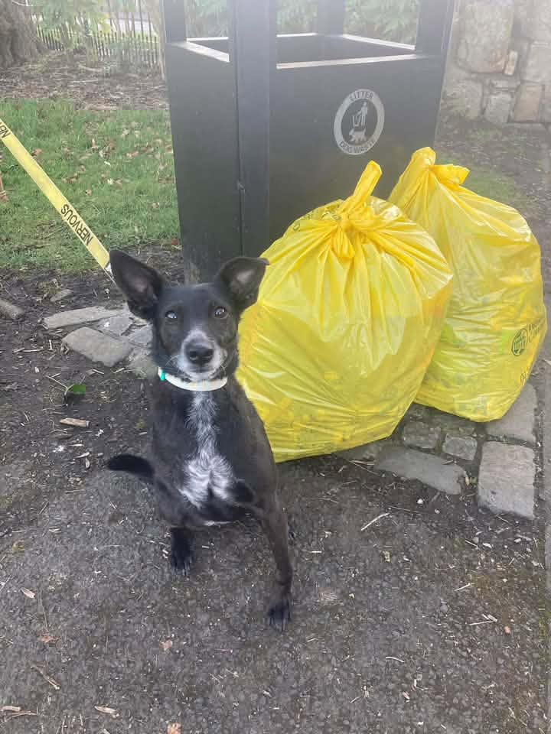
Agenda
Welcome/Apologies
Admin Team Introduction/Elections
Confirmation of minutes of previous AGM
Presentation of annual reports from:
  Chair
  Treasurer
  Secretary
  Education co-Ordinator
  Social media co-ordinator
Guest speakers
Constitution amendment and vote
Awards
AOB
Narnia (Dawn Lynch)

Slide 3
Welcome/Apologies
Welcome to all members and visitors
  WLC – Jane Ritchie, Interim Cleaner Communities Manager
  KSB – Emma Glencross, Senior Officer for Campaigns and Interventions.

Slide 4
Admin Team Introduction/Elections
  John Matthews - Chair
  Rebecca Gallagher - Secretary
  Kathy Parker - Treasurer
  Martin Keast – Education Coordinator
  Karen Howie - Social Media Coordinator
  Carol Salem – Committee member
Elections/re-elections

Slide 5
Previous AGM
Agree that the minutes of the 2025 AGM are a true reflection of what happened
The minutes have been posted on Facebook and Website

Slide 6
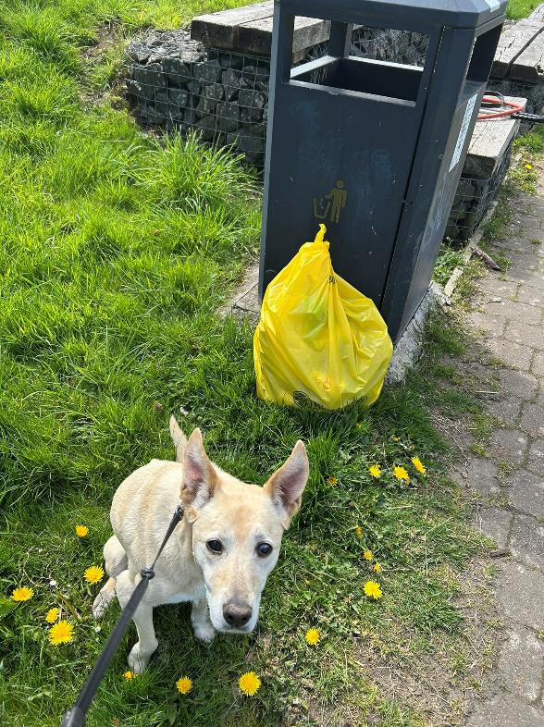
Chair’s report
John Matthews
Priorities
To strengthen the management team
Develop longer term plans
Continue to work closely with WLC and others
Holly (Martin Keast)

Slide 7
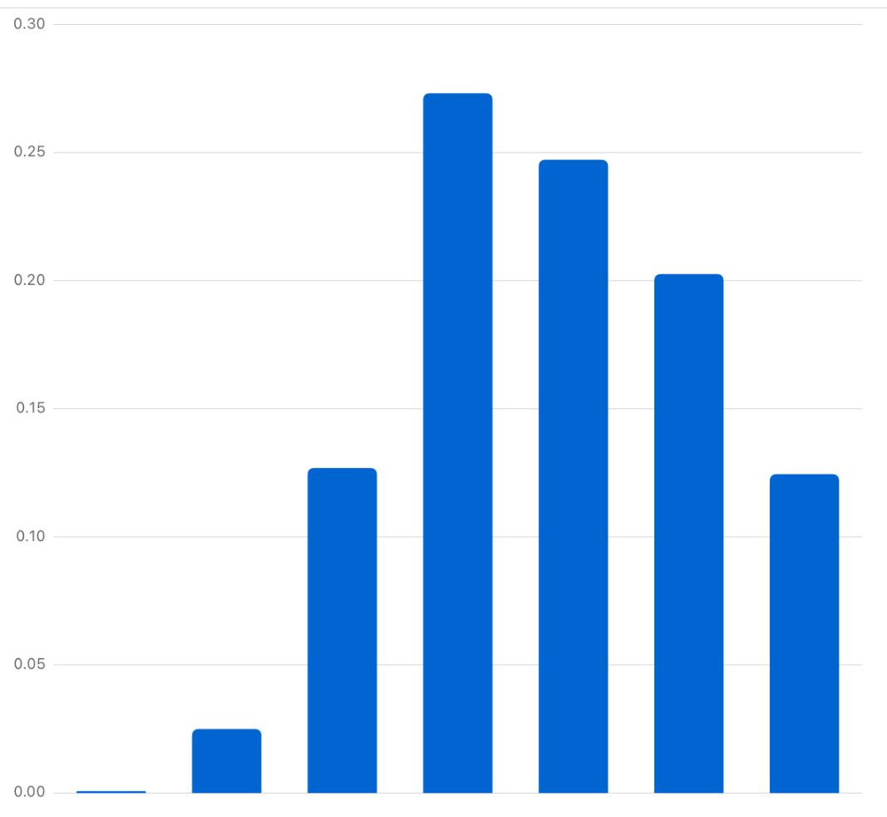
Membership analysis
35-44
45-54
55-64
Age group
25-34
65+
18-24
13-17

Slide 8
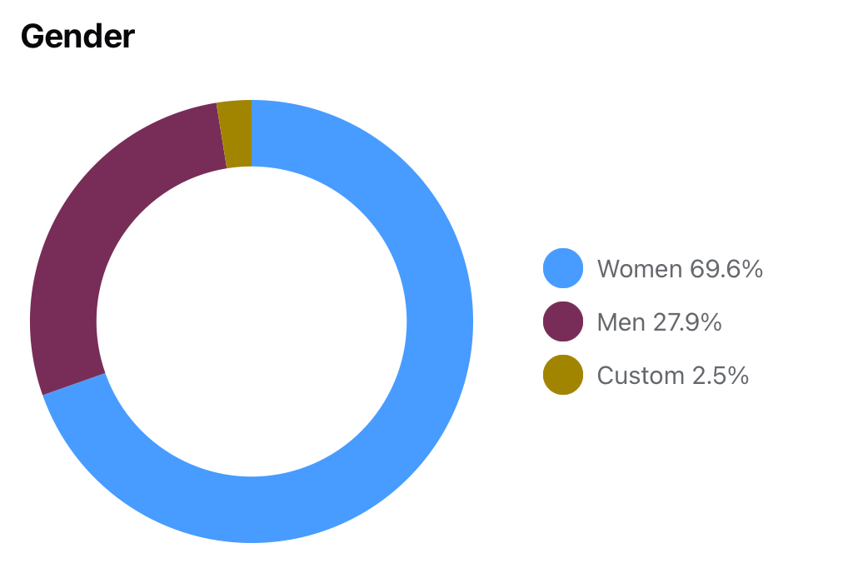
Membership analysis
Gender

Slide 9
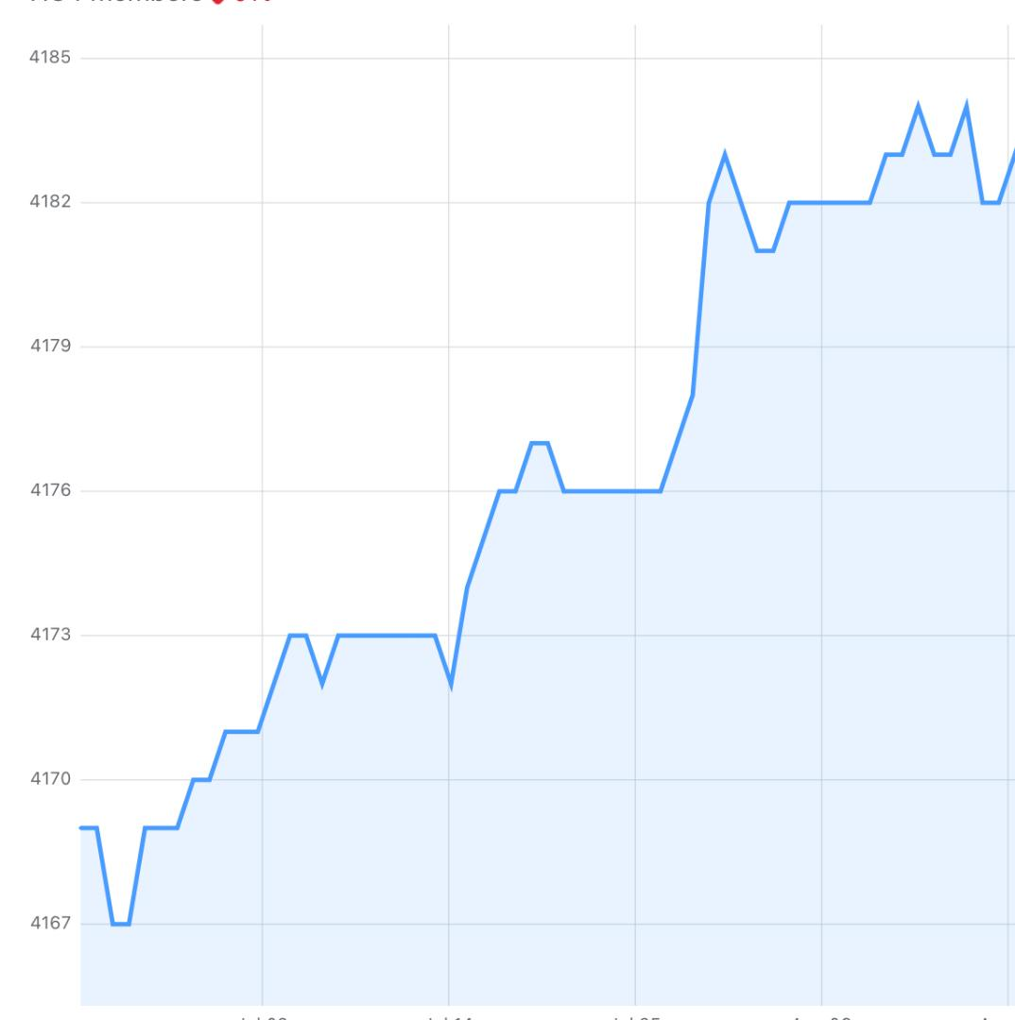
Membership Analysis
Growth over last 12 weeks
4168-4182 members

Slide 10
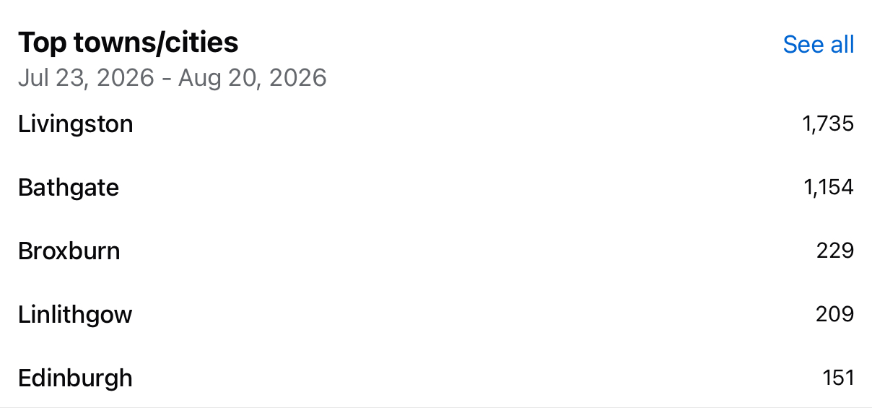
Membership Analysis

Slide 11
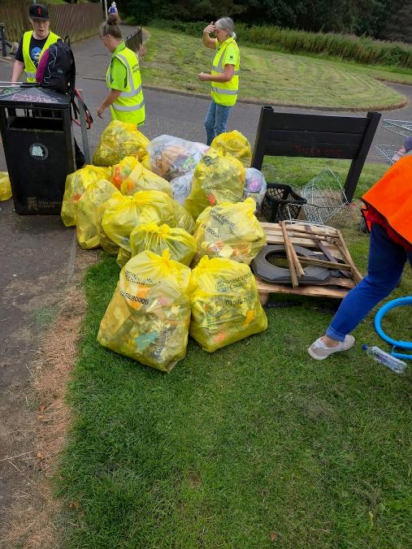
Treasurer's Report
Kathy Parker

Slide 12
Finance Report
General Donations £4,447
Grants received £6,000
Total Income £10,447
Expenditure £6,933
Surplus for the year £3,515
Current account 31st March 2026 £17,203
________________

Slide 13
Finance Report
Donations and Grants
Biffa supplied 80 litter picking kits and 100s of gloves and hi-viz vests
Co-operative Group £2,347.40
Woodland Trust £1,000.00
Collection tin: £62.23
Last week
National Lottery £6,000

Slide 14
Finance Report
Update since March Audit
Expenditure £3,386.88
Income £1,712.23*
Current Balance £15,528.99
* including sale of WLLP trailer

Slide 15

Secretary Report – Becky Gallagher
Main roles are:
Co-ordinate quarterly meetings between WLLP and WLC. The agenda is made up of ideas/suggestions/common themes gathered from our members and admin. Minutes from the meetings are available on the website.
I am the admin link between WLLP and Keep Scotland Beautiful where we are part of the Community Reference Group. We also pride ourselves taking part in the annual Spring Clean Scotland campaign where we came second this year.
I am also the admin link for Woodland Trust who have generously donated money to WLLP annually as well as work in partnership with us.
One of our biggest achievements in 2026 was finally getting the anti-litter campaign signage up on some of our most used roundabouts in West Lothian.

Slide 16
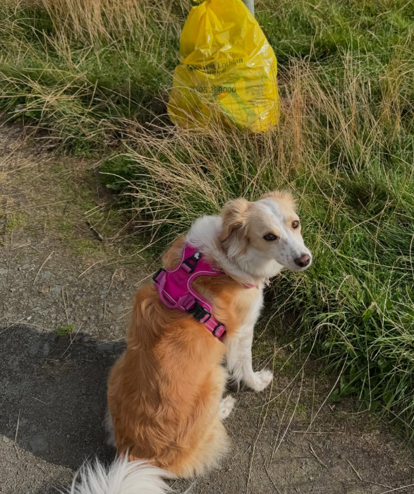
Social Media Coordinator’s report
Karen Howie
Isla (Karen Howie)

Slide 17
New activity
Since June:
  Created WLLP website
    (www.westlothianlitterpickers.co.uk)
  Set up Instagram account
    https://www.instagram.com/westlothianlitterpickers/
    @westlothianlitterpickers
    Already existed: #westlothianlitterpickers
Thank you to those who've allowed us to use their images!

Slide 18
Future plans
Future plans
  Regular news posting on social media with bag collection numbers (if possible), and other group news.
  Tidy up Facebook group so website becomes golden copy of instructions/information.
  Collecting data so we can more easily see what the group is doing.
  We are open to other suggestions!
Question – opinions please!
  Web form for collecting numbers of bags?
    For those that don't post on Facebook – would people use it?

Slide 19
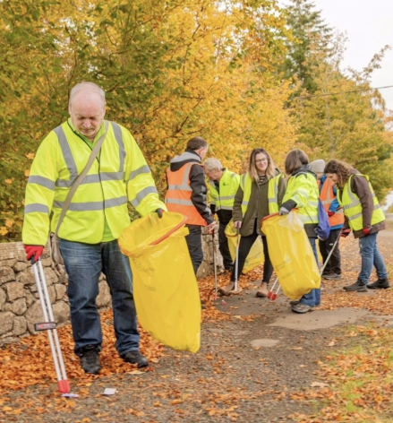

Martin Keast
Education Coordinator

Slide 20
How I see the role:
Raise awareness of WLLP in local schools
Design a range of related activities for use in Primary schools (linked to Spring Clean Scotland)
Liaise with the local secondary schools (survey)
Liaise with West Lothian Council

Slide 21
Guest Speakers
Emma Glencross, Keep Scotland Beautiful

Slide 22

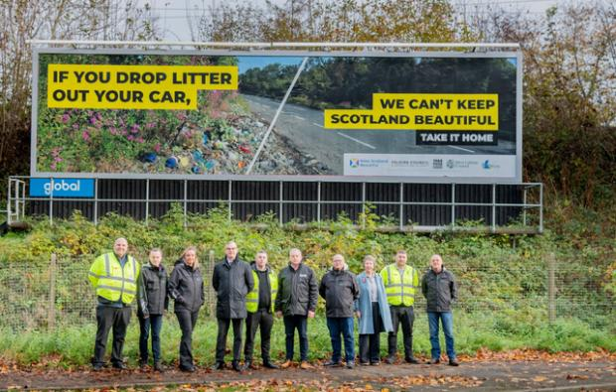
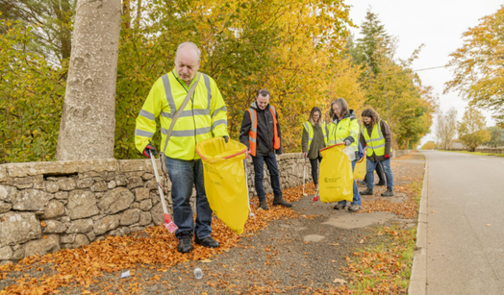
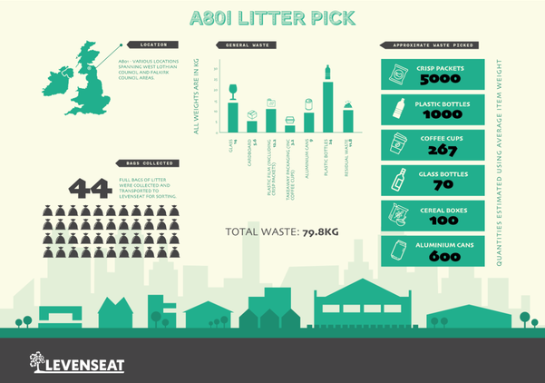

WLC & WLLP working together
A801 Road Side Litter Intervention
Following a successful PR day with KSB, Falkirk Council, WLLP, West Lothian Council and local Councillors the campaign was received successfully. 44 bags from a joint litter pick on the A801 Avongorge to Bowhouse Roundabout, Falkirk were taken and sent to Levenseat for a Composition Analysis

Slide 23

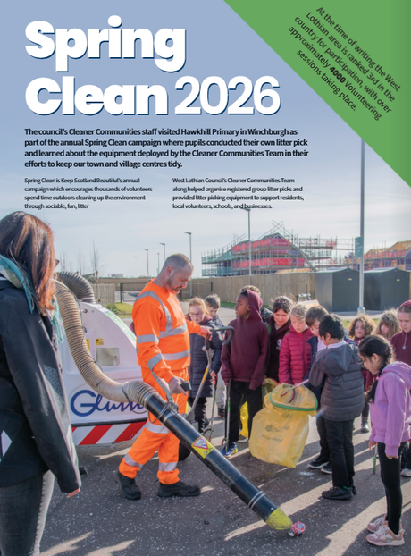



SPRING CLEAN SCOTLAND
#SpringCleanScotland2026 launched on 13 March. WLLP along with Cleaner Communities staff visited the new Hawkhill Primary School in Winchburgh where pupils conducted their own litter pick and learned about the equipment deployed by the Cleaner Communities Team in their efforts to keep towns and village centres tidy. WLLP members were very busy since the start of Spring Clean supporting over 400 litter picks. The figures for all your achievements are as follows:
  Estimated 6,674 Bags lifted
  4383 Volunteers registered with over 718 events (44 Schools taking part).
  West Lothian Litter Pickers were a #SpringCleanScotland Prize 2026 winner for registering their events, receiving a £100 voucher for Helping Hand Environmental.
  West Lothian Council were second in the Local Authority League Table.

Slide 24

ROADSIDE WEEK OF ACTION
West Lothian Council supported a national week of action on roadside litter coincided with the launch of #SpringCleanScotland2026. WLC Verge and Urban Clean Teams worked on core routes including A89/7066/B7066 spanning Broxburn to Heartlands and also joined up with Falkirk on the A801 Litter Intervention route. A total of 392 bags of litter was lifted over the week and supported by volunteers from West Lothian Litter Pickers with a joint pick adding a further 52 bags worth of waste collected.
Temporary roadworks signs with messages including '#Drive Your Litter Home' & '#Fly-tipping In This Lay-by Nets You a £500 FPN' were deployed along the route and have been since been re-deployed throughout West Lothian.
COMMUNITY CLEAN UP DATA
467 Community Clean-up Enquiries between September 2025 and September 2026.
462 via E-Forms.
482 Community Clean-up Jobs are recorded
Approximately 3351 Bags collected (avg 7kg per bag)
Approx Total collected 23.457 Tonnes, Disposal cost £2,767.93

Slide 25
Any questions for KSB/WLC

Slide 26
Our constitution
It is an official written rulebook.
It explains the core purpose of the group and how it will be run.
It acts as a guide for the admin team and members
Any changes have to be approved by the membership
It is also frequently requested by funders

Slide 27
Constitution amendment and vote
Many of the terms are outdated or inappropriate for the organisation
Many of the clauses are overly complicated and confusing
The legislation quoted in the constitution is now outdated
There is no reference to GDPR requirements
There is no commitment to diversity or inclusion
The old constitution covers 11 pages and 3670 words
The new constitution covers 4 pages and 1026 words

Slide 28
Awards
WLLP branded high-vis jackets were awarded to a number of the community for their impact in reducing the litter in West Lothian.

Slide 29
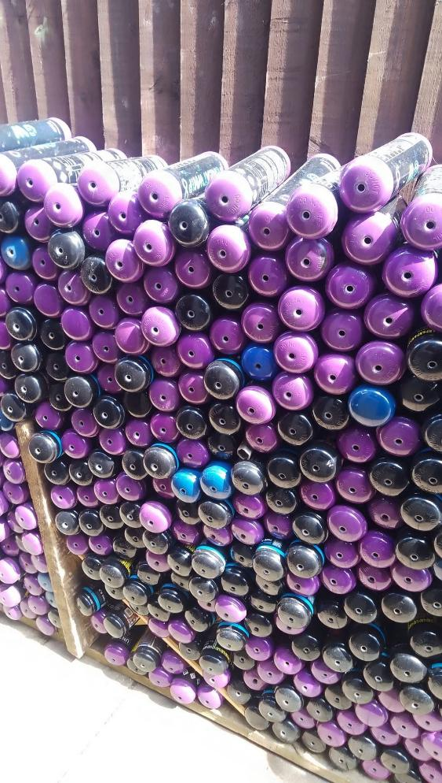
AOB
Nitrous Oxide Cannisters

